Slide 1
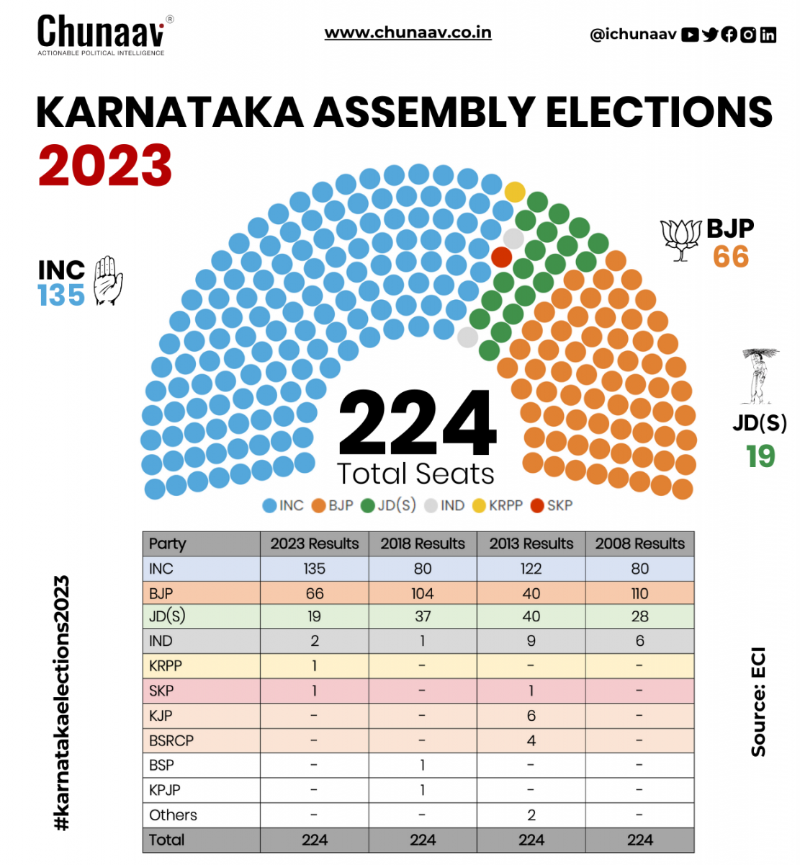
KarnaTka-Assembly Result
Under The Guidance Of
Mr. Diwakara Vasuman M S
Dept. Of MCA
Presented by
Rahul Kumar
1DT22MC037

Slide 2
Introduction
Karnataka, located in the southern part of India, is one of the country's most vibrant states with a rich cultural heritage, economic diversity, and linguistic plurality. Its capital, Bengaluru, is known as the Silicon Valley of India due to its booming IT industry and innovation ecosystem. Karnataka boasts a blend of urban modernity and rural traditions, making it a microcosm of India's diversity. Indian politics,
Karnataka holds significant importance due to several factors:Political Landscape: Karnataka has a multi-party political system with prominent parties like the Indian National Congress (INC), Bharatiya Janata Party (BJP), and Janata Dal (Secular) (JD(S)) vying for power.Electoral Significance: With 224 assembly seats, Karnataka contributes significantly to the Lok Sabha (lower house of parliament) with 28 seats, making it a crucial battleground during national elections.

Slide 3
Objectives
Understanding Voter Preferences: Election results illuminate voting patterns, preferences, and sentiments of the electorate across Karnataka.
Assessing Political Landscape: Results reveal the political landscape, strengths, weaknesses of parties, and the emergence of new players.
Policy Implications: Insights into the electorate's mandate aid policymakers in formulating responsive policies aligned with public priorities.
Regional Dynamics: Analysis unveils regional variations in political preferences, socio-economic factors, crucial for inclusive development.
Strategic Planning for Political Parties: Results inform strategic decisions on candidate selection, campaign strategies, and coalition formations for future elections

Slide 4
About Dataset
Election Commission of India (ECI): Official website for detailed election results.
Government of Karnataka: Official website for election results and related datasets.
Open Data Portals: Websites like data.gov.in host election-related datasets.
News Websites and Research Organizations: They often compile and publish election results datasets for public access and analysis.
_id | State_Name | Assembly_No | Constituency_No | Year | month | DelimID | Poll_No | Position | Candidate | Sex | Party | Votes | Age | Candidate_Type | Valid_Votes | Electors | Constituency_Name | Constituency_Type | District_Name | Sub_Region | N_Cand | Turnout_Percentage | Vote_Share_Percentage | Deposit_Lost | Margin | Margin_Percentage | ENOP | pid | Party_Type_TCPD | Party_ID | last_poll | Contested | Last_Party | Last_Party_ID | Last_Constituency_Name | Same_Constituency | Same_Party | No_Terms | Turncoat | Incumbent | Recontest | MyNeta_education | TCPD_Prof_Main | TCPD_Prof_Main_Desc | TCPD_Prof_Second | TCPD_Prof_Second_Desc | Election_Type

Slide 5
Conclusion
The Karnataka Assembly election marks not just the end of a political process but the beginning of a new chapter in the state's journey towards progress and development. It is our collective responsibility to honor the mandate of the electorate and strive towards building a brighter future for Karnataka and its people.

Slide 6
Software Requirements
Python
JupyterNotebook
Hardware Requirements
I3Processor
• 4GBRAM

Slide 7
Thank you

